Slide 1

yoga pose detection using deep learning
Team Members :
Kota Rama Sai Vamsi
Hariram S
Sunayana P
Gokul Pandian M
Guide :
M Sankara Mahalingam

Slide 2
Contents :
Introduction
Objective of the project
Motivation
Literature Review
Methodology
Issues to be addressed
Survey
Output
Acceptance Proof
References

Slide 3
Introduction
In recent years, deep learning has revolutionized many fields, including computer vision, natural language processing, and speech recognition.
How deep learning models can be used for pose detection in yoga, a popular form of exercise that has numerous physical and mental health benefits. The goal of my research is to develop a real-time system that can accurately detect yoga poses and calculate angles in real-time, allowing practitioners to monitor their form and progress.
Discuss the methods used for data preprocessing, pose detection, and angle calculation, as well as the advantages and limitations of using pretrained models. I will also present the results of my research, which demonstrate the potential of this approach in improving the accuracy and efficiency of yoga pose detection.

Slide 4
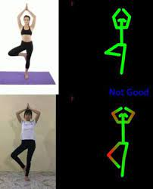
Objective :
The main objective of yoga pose grading is to assess the input yoga pose and compare it to a standard pose in order to provide a quantitative evaluation as a grade.
With our fast-paced lives these days, people usually prefer exercising at home but feel the need of an instructor to evaluate their exercise form.
Human pose recognition can be used to build a self-instruction exercise system that allows people to learn and practice exercises correctly by themselves.

Slide 5
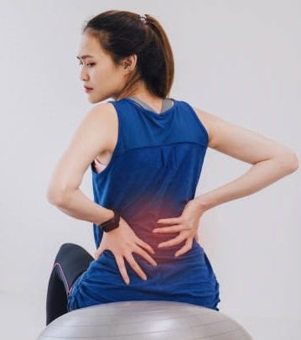
Motivation :
By attempting to exploit the opportunity of self at-home wrong practice can lead muscle cramps ,joint pains ,back pain and muscle soreness ,and better results will not be seen.
For recognizing and correcting yoga poses in real-time, with the motive to address the lack of availability of proper training and to make such education more affordable and suitable for people.

Slide 6
Literature review :
Sl.no | Title | Conference with year | Algorithm /Technique | Drawbacks /Improvements
1. | Head Pose Estimation in Computer Vision: A Survey | April 2009 | Manifold embedding methods ,Hybrid methods ,Tracking methods | Optical motion capture systems
2. | Pose Estimate Based Yoga Instructor | February 2021 | CNN,RNN,GAN | Precise and personal guidance will be pro- vided by the AI
3. | AI-Based Yoga Pose Estimation for Android Application | September 2020 | PoseNet-TensorFlow-Lite framework. | Model performs very fast and accuracy
4. | 3D Human Pose Estimation = 2D Pose Estimation + Matching | December-2017 | Image-Based 2D Pose Estimation-CNN, Nonparametric 3D shape model | 3D human pose estimation by performing 2D pose estimation, followed by 3D exemplar matching

Slide 7
5. | Evaluation of Machine Learning Techniques for Hand Pose Estimation on Handheld Device with Proximity Sensor | April 2020 | Convolutional neural network , network architectures | Intuitive interaction using fingers in VR applications.
6. | Fast Human Pose Estimation | Jan 2019 | Lightweight pose neural network , pre train teacher network , pose Knowledge Distillation | Capable of executing rapidly with low computational cost
7. | DeepLabCut: markerless pose estimation of user-defined body parts with deep learning | August 2018 | Deep neural networks,number and location of the markers must be determined a priori | Even when only a small number of frames are labeled algorithm achieves excellent tracking performance
8. | Introduction to Camera Pose Estimation with Deep Learning | Jul 2019 | CNN ,Regressing the absolute camera pose from an RGB image, | Cross-comparison of existing learning-based pose estimator

Slide 8
Deep Learning Models for Pose Detection:
OpenPose and MediaPipe are two widely used deep learning models for pose detection.
OpenPose uses a combination of convolutional neural networks and geometric matching to estimate the pose of multiple people in an image or video. It can detect up to 135 keypoints, including the locations of body joints, eyes, ears, and nose. OpenPose is open-source and free to use, making it popular among researchers and developers.
MediaPipe, on the other hand, is a framework that offers a range of pre-built models for various tasks, including pose estimation. MediaPipe's BlazePose is a lightweight and efficient model that can estimate 33 keypoints of a human pose, such as the locations of body joints and torso center. BlazePose can run in real-time on mobile devices, and its small size makes it ideal for resource-constrained environments. Both models offer high accuracy and speed, making them suitable for various applications, such as fitness tracking, motion capture, and augmented reality.

Slide 9
Pose Detection and Angle Calculation:
OpenPose and MediaPipe are deep learning models that accurately detect and track key body joints in yoga poses.
Inputting an image or video of the practitioner's pose allows the model to create a skeleton representation and calculate angles between different body parts.
Real-time feedback provided by the models can help practitioners improve their form and avoid common mistakes that may lead to injury, This technology is particularly useful for beginners who may not be familiar with proper alignment.
These models provide a powerful tool for enhancing yoga practice and achieving maximum benefits.
In recent years, technology has been used to enhance traditional methods of yoga instruction, such as the Cue method, by providing visual cues or animations to demonstrate proper alignment for each pose.
Deep learning models for pose detection and angle calculation offer a promising future for yoga practice, as they provide objective feedback that can supplement traditional methods of instruction.

Slide 10
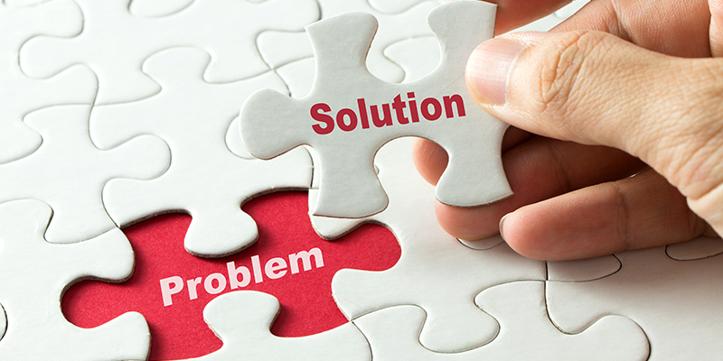
Issues to be addressed :
Time saving through use of pose detection model
Cheaper than yoga centers
More Convenient than going to yoga centers
Correcting the pose for better results
Easy to Engage
Higher Privacy
Convenience of Access
Working as a guide for training

Slide 11
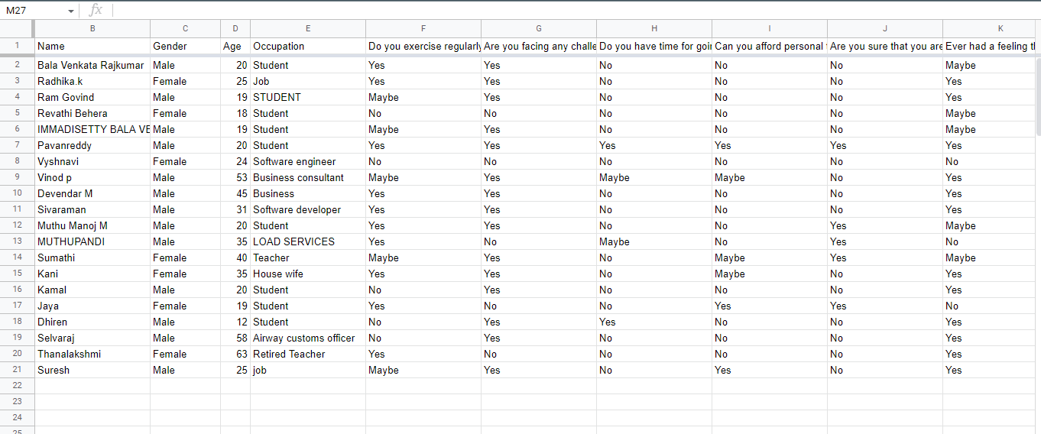
Survey :

Slide 12
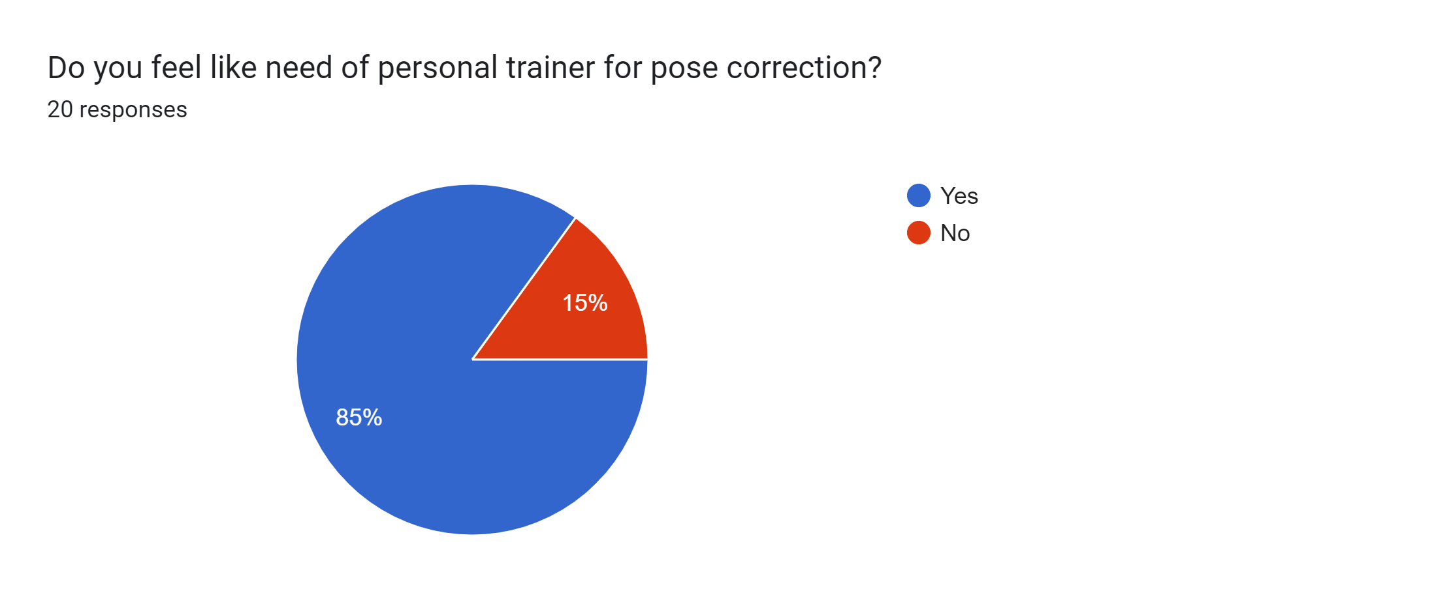
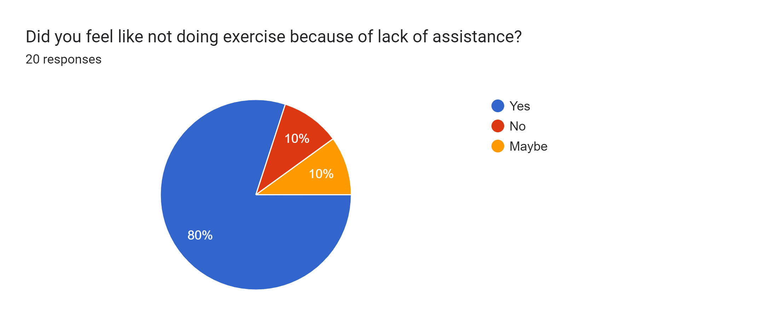
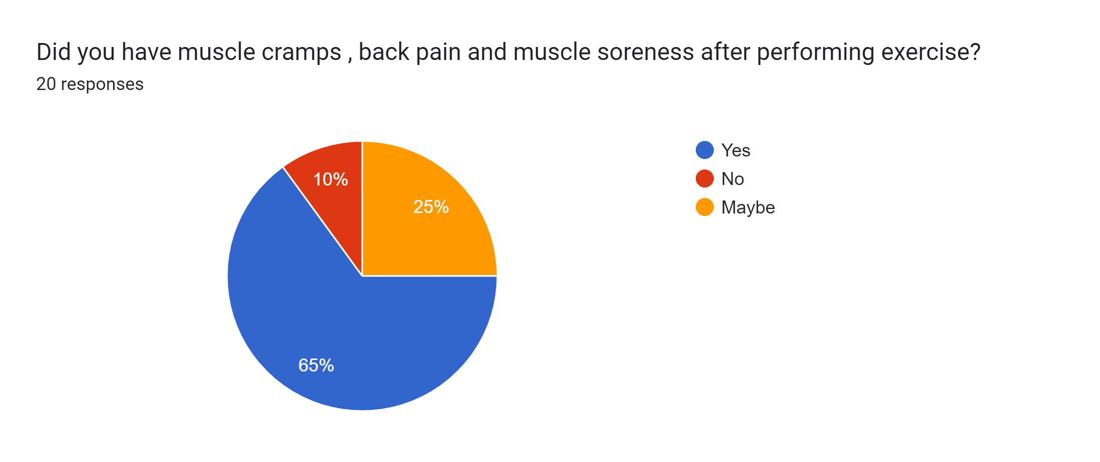
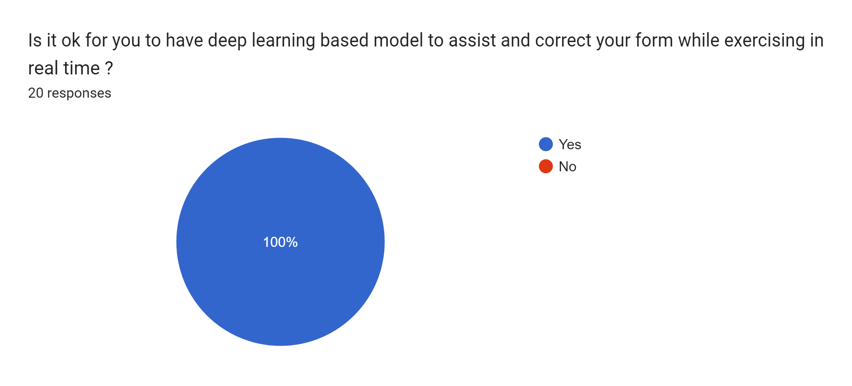

Slide 13
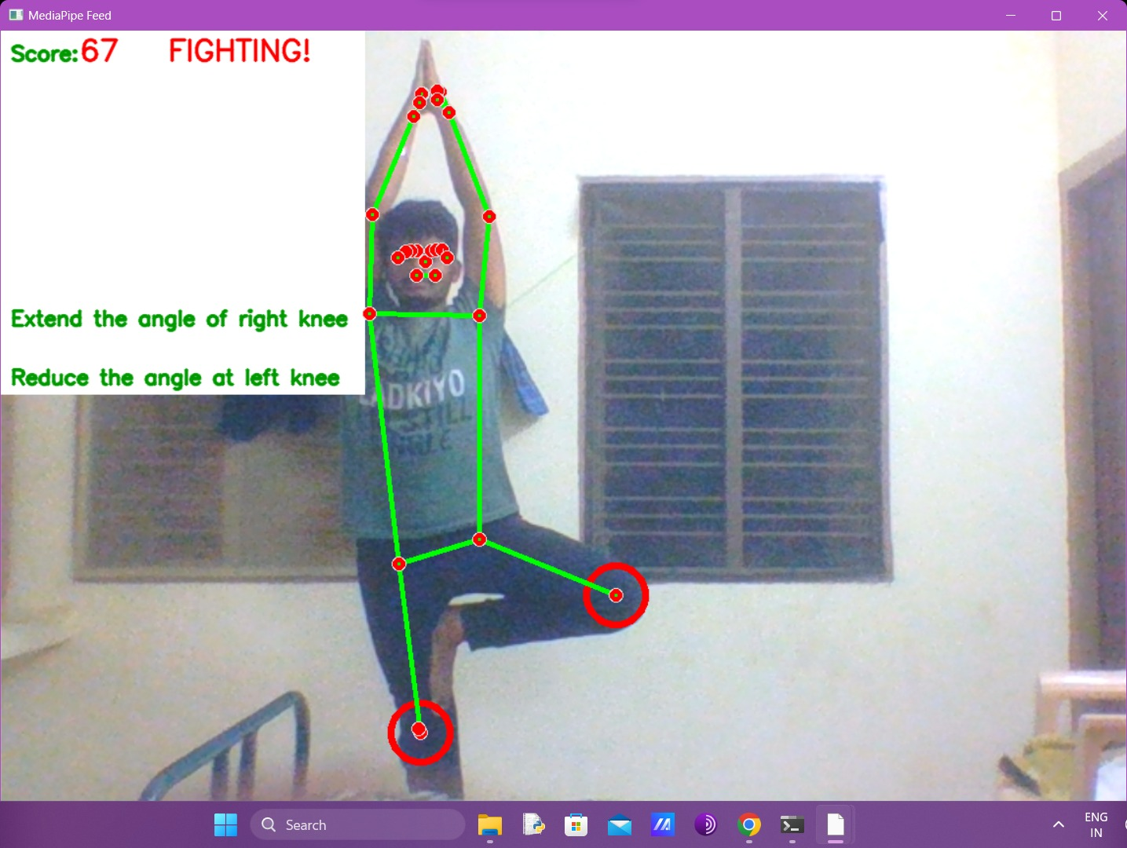
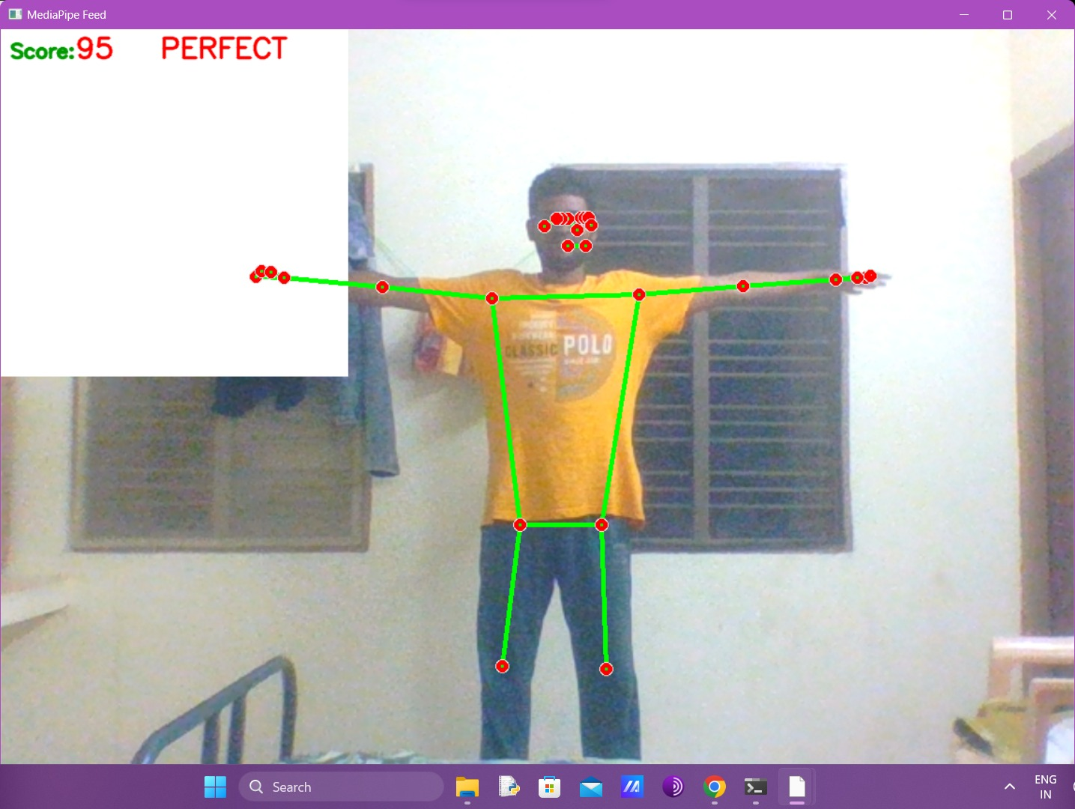
Output :

Slide 14
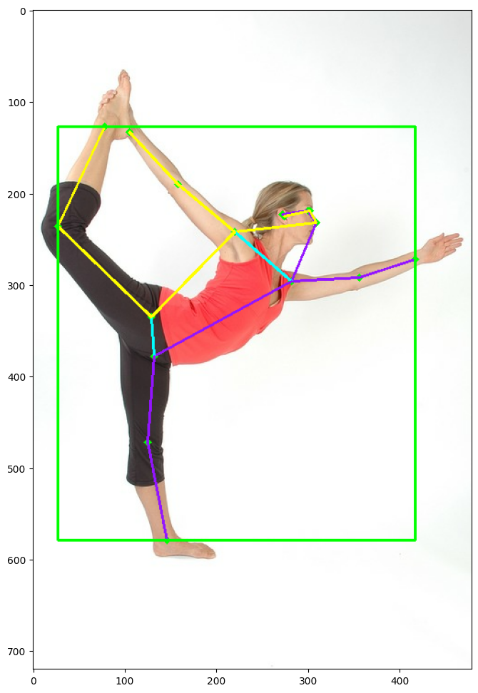
Results :
Results from these models can be used to provide real-time feedback to practitioners and instructors, allowing for immediate adjustments to form and alignment.
One limitation of these models is that they rely on clear and unobstructed views of the practitioner's body. If the image or video input is blurry or obstructed, the model may not accurately detect all the key body joints, leading to inaccurate angle calculations.
Overall, pose detection and angle calculation using OpenPose and MediaPipe provide a promising tool for enhancing yoga practice. Further research and development in this area can lead to improved accuracy and performance of these models, allowing for more effective feedback and analysis of yoga practice.

Slide 15
References :
A Bakshi, D. Sheikh, Y. Ansari, C. Sharma, and H. Naik, “Pose Estimate Based Yoga Instructor”, IJRAMT, vol. 2, no. 2, pp. 70–73, Mar. 2021.
Chiddarwar, Girija Gireesh, et al. "AI-based yoga pose estimation for android application." Int J Inn Scien Res Tech 5 (2020): 1070-1073.
E. Murphy-Chutorian and M. M. Trivedi,” Head Pose Estimation in Computer Vision: A Survey,” in IEEE Transactions on Pattern Analysis and Machine Intelligence, vol. 31, no. 4, pp. 607-626, April 2009.
Chen, Ching-Hang, and Deva Ramanan. "3d human pose estimation= 2d pose estimation+ matching." Proceedings of the IEEE conference on computer vision and pattern recognition. 2017.
Arimatsu, K., & Mori, H. (2020, April). Evaluation of machine learning techniques for hand pose estimation on handheld device with proximity sensor. In Proceedings of the 2020 CHI Conference on Human Factors in Computing Systems .
Zhang, F., Zhu, X., & Ye, M. (2019). Fast human pose estimation. In Proceedings of the IEEE/CVF Conference on Computer Vision and Pattern Recognition (pp. 3517-3526).
Mathis, Alexander, et al. "DeepLabCut: markerless pose estimation of user-defined body parts with deep learning." Nature neuroscience 21.9 (2018): 1281-1289.
Shavit, Y., & Ferens, R. (2019). Introduction to camera pose estimation with deep learning. arXiv preprint arXiv:1907.05272.

Slide 16
Thank you

